Slide 1
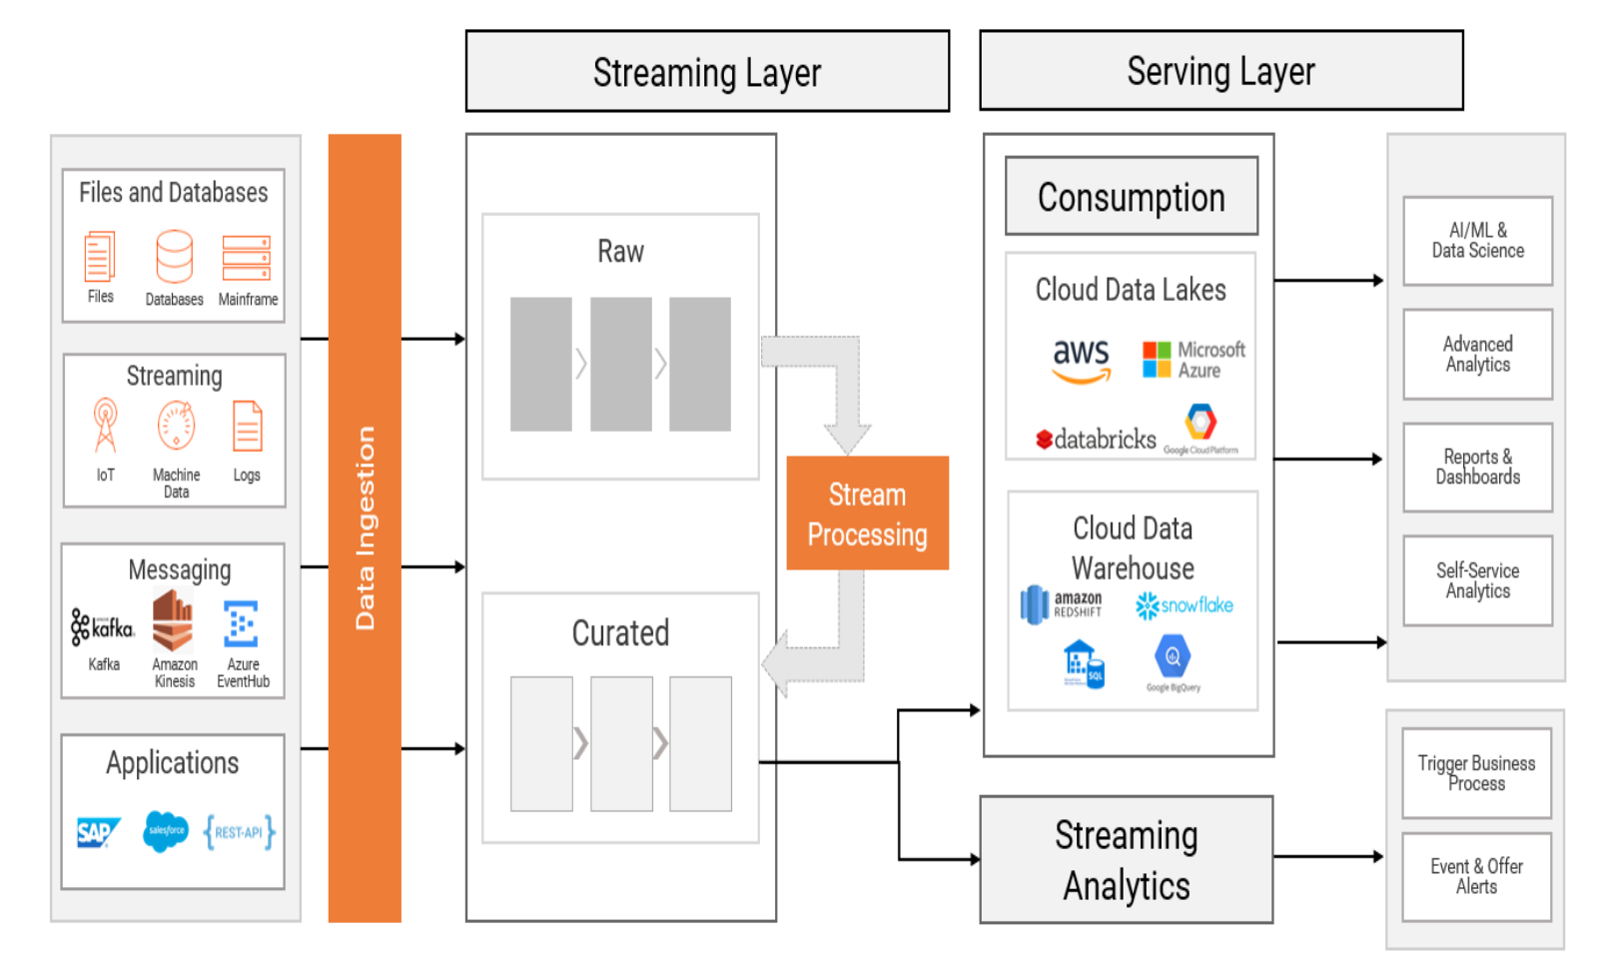
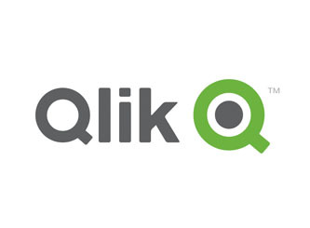

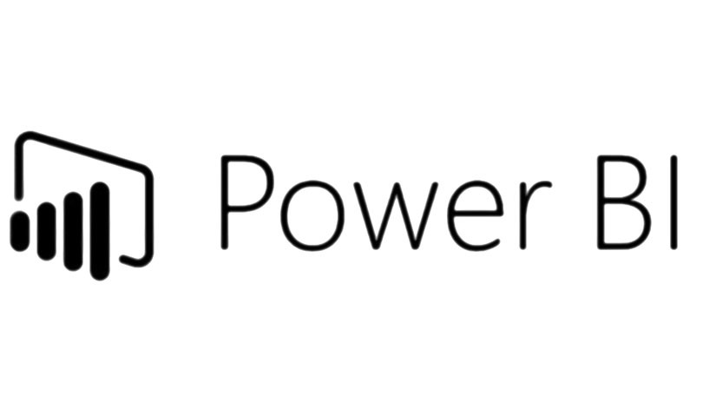
Assuming there are various data sources (IoT etc), all these data can be ingested through informatica streaming and ingestion platform where streaming/batch processing will take place in the stream layer to enrich the data.
The data is then distributed to the serving layer such as a cloud data lake, cloud data warehouse, operational intelligence or alerting systems for self-service analytics and machine learning (ML), reporting, dashboarding, predictive and preventive maintenance as well as alerting use cases.
Once the data is processed, various BI tool like tableau or Qliksense could be integrated with the data storage (RDMBS etc) to extract the data for visualisation.
Notes:
Reference informatica

